Slide 1

2024 3rd International Conference on Innovation in Technology (INOCON)
CONSTRUCTION OF SMART IRRIGATION SYSTEM USING CISCO PACKET TRACER
Paper ID: 1586
Presenter Name: Mohammed Arshad A
Affiliation: Sathyabama Institute of Science and Technology, Chennai

Slide 2

ABSTRACT
Irrigation system is a method used to supply water to the plants as uniformly as possible. In the Internet of Things (IoT), technology devices or sensors are connected via the internet and can be remotely operated and monitored by the user. The implementation is done by performing the simulation for a smart irrigation system with the help of the Cisco packet tracer simulation software with new version Cisco Packet Tracer 7.3.0 (64-bit). This technology can be implemented for developing a smart irrigation system, which consists of devices like a lawn sprinkler, temperature monitor, humidity monitor, etc., to automate the watering system and remotely monitor the environmental conditions for better growth of the plants. All the devices are connected to the home gateway and can be remotely operated and monitored using a Tablet/PC/Smartphone.

Slide 3
INTRODUCTION
IoT technology addresses challenges faced by farmers/homeowners in maintaining proper irrigation systems amidst changing environmental conditions. Smart irrigation systems automate watering based on water level readings from monitors, ensuring efficient water usage. Humidity sensors enable automated control of humidifiers to maintain optimal humidity levels for plant growth. Various environmental sensors such as temperature, pressure, CO2, CO, wind, and humiture monitors contribute to monitoring plant health and growth. Smart devices are connected to a home gateway, enabling remote operation and monitoring via tablets, PCs, or smartphones. Motion detector alarms enhance security by alerting owners to animal presence near the irrigation field. Cisco Packet Tracer simulation tool facilitates the visualization and testing of network topologies and device integration, aiding in the development of smart irrigation systems.

Slide 4
LITERATURE SURVEY AND PROBLEM FORMULATION
S. NO | TITLE | AUTHOR | YEAR | PROBLEM STATEMENT
1 | Internet of Things (IoT) and its Challenges for Usability in Developing Countries | Egemen Hopalı, Özalp Vayvay | 2018 | Developing countries face challenges in implementing IoT due to lack of infrastructure, poor internet, security risks, privacy issues, limited skilled workforce, and low value-added production.
2 | Using Cisco Packet Tracer to simulate Smart Home | Ghaliya Alfarsi, Ragad M Tawafak, Abir Alsidiri, Jasiya Jabbar, Sohail Iqbal Malik, Maryam Alsinani | 2019 | Limited real-world testing, potential security vulnerabilities, dependence on stable internet connection, and lack of consideration for user privacy and data protection in smart home simulations.
3 | IoT-based intelligent irrigation management and monitoring system using Arduino | Fidaus Kamaruddin , Nik Noordini Nik Abd Malik, Noor Asniza Murad, Sharifah Kamilah Syed Yusof, Shipun Anuar Hamzah | 2018 | Reliance on internet connectivity, limited distance for wireless communication, complexity of system setup, and potential issues with sensor accuracy and reliability in real-world conditions.

Slide 5
OBJECTIVE
The main objective of this research is to create and test a smart watering system using the Internet of Things (IoT) technology. We want to make it so that people can control their garden watering from anywhere using a smartphone or computer. The system will include devices like a sprinkler and sensors to check things like temperature and humidity. We'll use a program called Cisco Packet Tracer to simulate how the system works. Our main objectives are to set up and connect all the devices in the simulation, make sure they can communicate with each other through a central hub, and program them to automatically water the garden based on the soil's moisture level. We also want to see if this system can help people save water and keep their plants healthy.

Slide 6
MODULES
The main step is to connect the home gateway device to the network and configure the home gateway to provide internet access and connect to the IoT devices.
Connect the various IoT devices such as lawn sprinkler, water level monitor, water drain, light indicator, temperature monitor, pressure monitor, humiture monitor, humidity monitor, humidifier, CO2 detector, CO detector, smartphone, and thermostat to the home gateway.
Configure each sensor to send data to the home gateway. Set up parameters such as threshold levels for different environmental factors like temperature, humidity, and pressure.
Use programming logic (e.g., if-then conditions) to control the irrigation system based on sensor readings. Define actions for the lawn sprinkler, water drain, and humidifier based on the data received from sensors.
Configure the smartphone to connect to the home gateway remotely. Develop a user interface on the smartphone for monitoring sensor data and controlling the irrigation system.
Test the system to ensure proper functioning of all components. Optimize the system settings and programming logic for efficient irrigation management.

Slide 7
EXISTING MODEL
One paper presents a greenhouse monitoring system using IoT and cloud storage, while another focuses on an automated irrigation system employing Raspberry Pi and Arduino microcontrollers. Another paper describes a smart home system utilizing IoT technology for automation via Cisco Packet Tracer. Another theme involves high-level monitoring and control of agricultural data using Raspberry Pi and cloud-based IoT. Utilizing advanced IoT sensors like NodeMCU, soil moisture sensors, weather stations, and humidity sensors, real-time data is collected and transmitted wirelessly to a central control system. This sophisticated system leverages the gathered data to dynamically control actuators, optimizing water usage. Unlike traditional irrigation schedules tied to specific times and durations, the IoT-driven approach ensures a more responsive and efficient agricultural process, mitigating economic and operational disadvantages present in the existing system.

Slide 8
PROPOSED MODEL
The Smart Irrigation system is designed using a software called Cisco Packet Tracer. It involves a tablet and a home gateway that connect to different devices like temperature monitors, lawn sprinklers, and water level sensors. The home gateway links all the sensors and uses conditions like "if-then" actions to control the lawn sprinklers. In the future, storing data and analytics in the cloud is becoming popular. This makes it easy to access and analyze data, and allows for collaboration among farmers and experts. Some systems also include disease and pest monitoring using cameras and special software. This helps farmers spot problems early and take action to fix them.

Slide 9
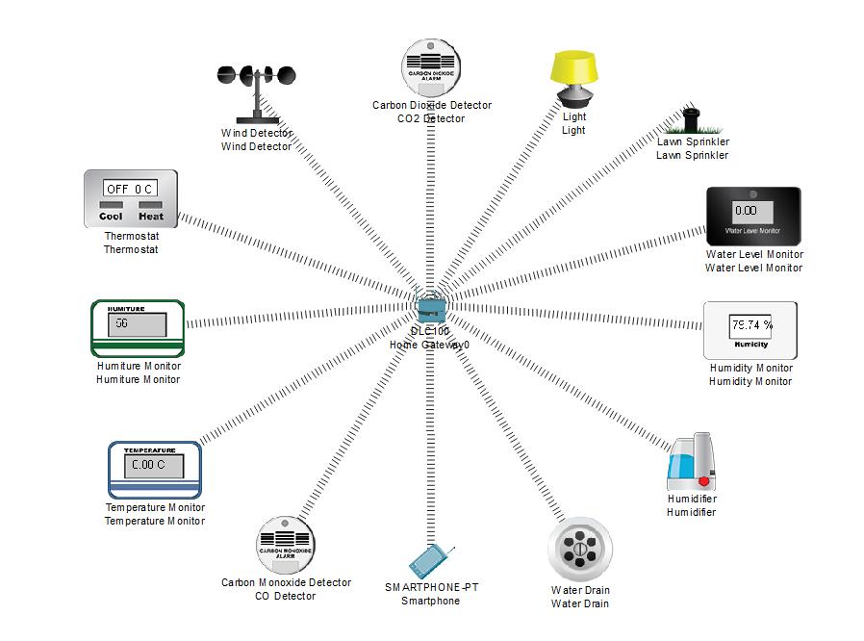
SYSTEM ARCHITECTURE

Slide 10
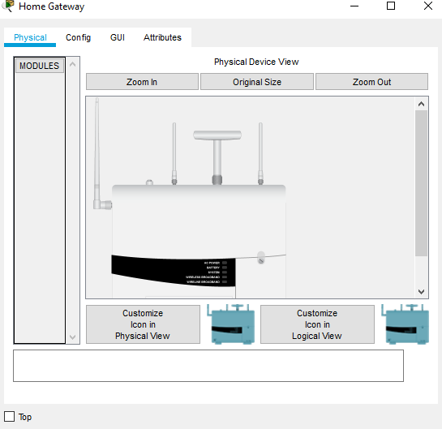
PHYSCIAL CONFIGURATION OF HOME GATEWAY

Slide 11
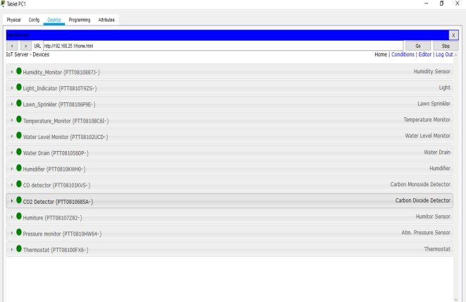
IoT DEVICES DISPLAYED ON THE SMARTPHONE

Slide 12
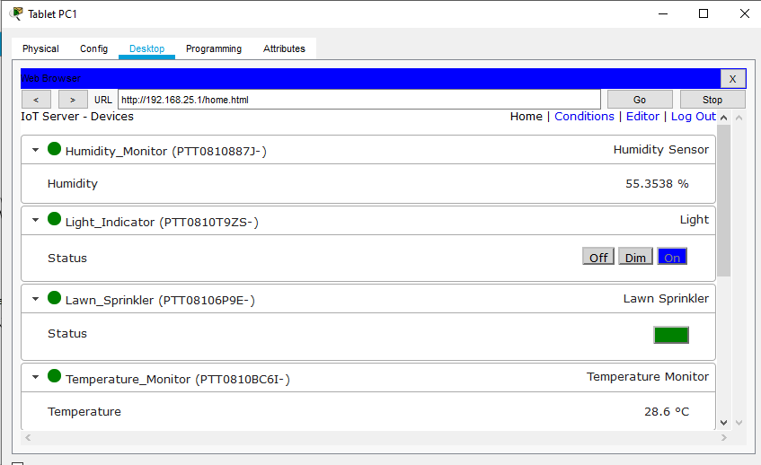
NUMERICAL VALUES OF THE SENSORS

Slide 13
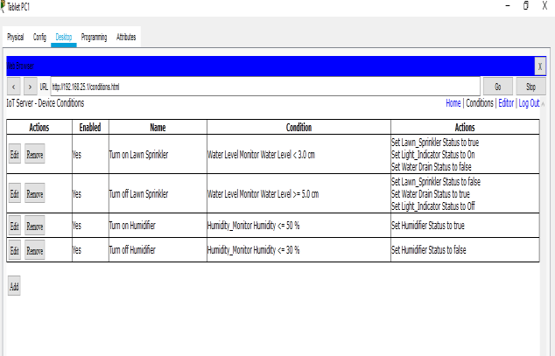
CONDITIONS SET FOR THE AUTOMATIC SYSTEM

Slide 14
RESULTS
After registration of the devices with the home gateway, to control the IoT devices remotely using a tablet. The registered IoT devices can be viewed on the tablet. The devices can be manually operated as well as the values can be viewed and monitored in real-time. It shows the numerical values of the sensors that are displayed on the Tablet. It shows the status of the IoT devices registered with the home gateway. These devices can be manually as well as automatically monitored. The tablet interface allows users to set personalized irrigation schedules, optimizing water distribution based on real-time monitoring and device data.

Slide 15
CONCLUSION
The results prove that there is an opportunity of applying this model in real life. The implementation of the automatic irrigation system can be used to reduce the use of water. The system can be manually monitored, it can increase the energy efficiency and savings. It also makes it convenient for the user to access all the devices through the smartphone. In the field of IoT, ensuring security should be a priority. Since the IoT devices are interconnected to each other, the network should be secured. In this system, an authentication gateway is designed that requires password to check authenticity of the home user for security purpose. To extend this system to be more robust and efficient in the future, modifications can be made to make the system more secure.

Slide 16
REFERENCES
[1] Egemen Hopalı, Özalp Vayvay, “Internet of Things (IoT) and its Challenges for Usability in Developing Countries” International Journal of Innovation Engineering and Science Research, Vol. 2 , Issue. 1 January 2018
[2] Ghaliya Alfarsi, Ragad M Tawafak, Abir Alsidiri, Jasiya Jabbar, Sohail Iqbal Malik, Maryam Alsinani, “Using Cisco Packet Tracer to simulate Smart Home”, Vol. 8 , Issue 12, December 2019
[3] R. N. Rao and B. Sridhar, "IoT based smart crop-field monitoring and automation irrigation system," 2018 2nd International Conference on Inventive Systems and Control (ICISC), Coimbatore, pp. 478-483, 2018, doi: 10.1109/ICISC.2018.8399118.
[4] Isa Shemsi, “Implementing smart home using cisco packet tracer”, IJERT, Vol.4, Issue.7, January 2018.

